Slide 1



2023_Acavents
View in Power BI
Last data refresh:
7/19/2023 1:22:11 PM UTC
Downloaded at:
10/25/2023 12:13:47 PM UTC

Slide 2
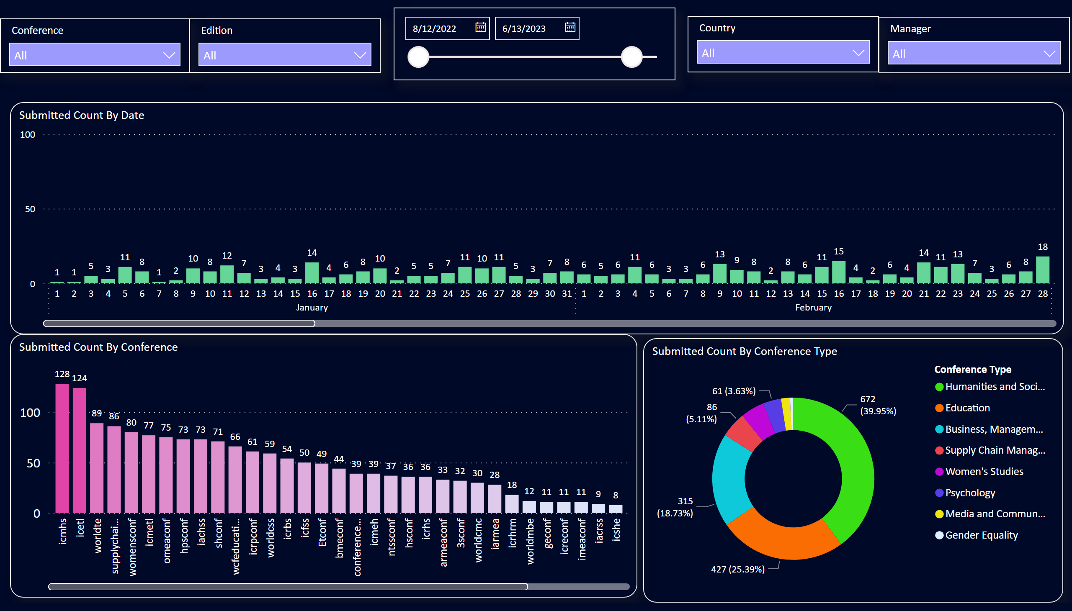
Conference_Submission
Notes:
Submitted Count By Date
No alt text provided
Submitted Count By Conference
No alt text provided
Submitted Count By Conference Type
No alt text provided
slicer
No alt text provided
slicer
No alt text provided
slicer
No alt text provided
slicer
No alt text provided
slicer
No alt text provided

Slide 3
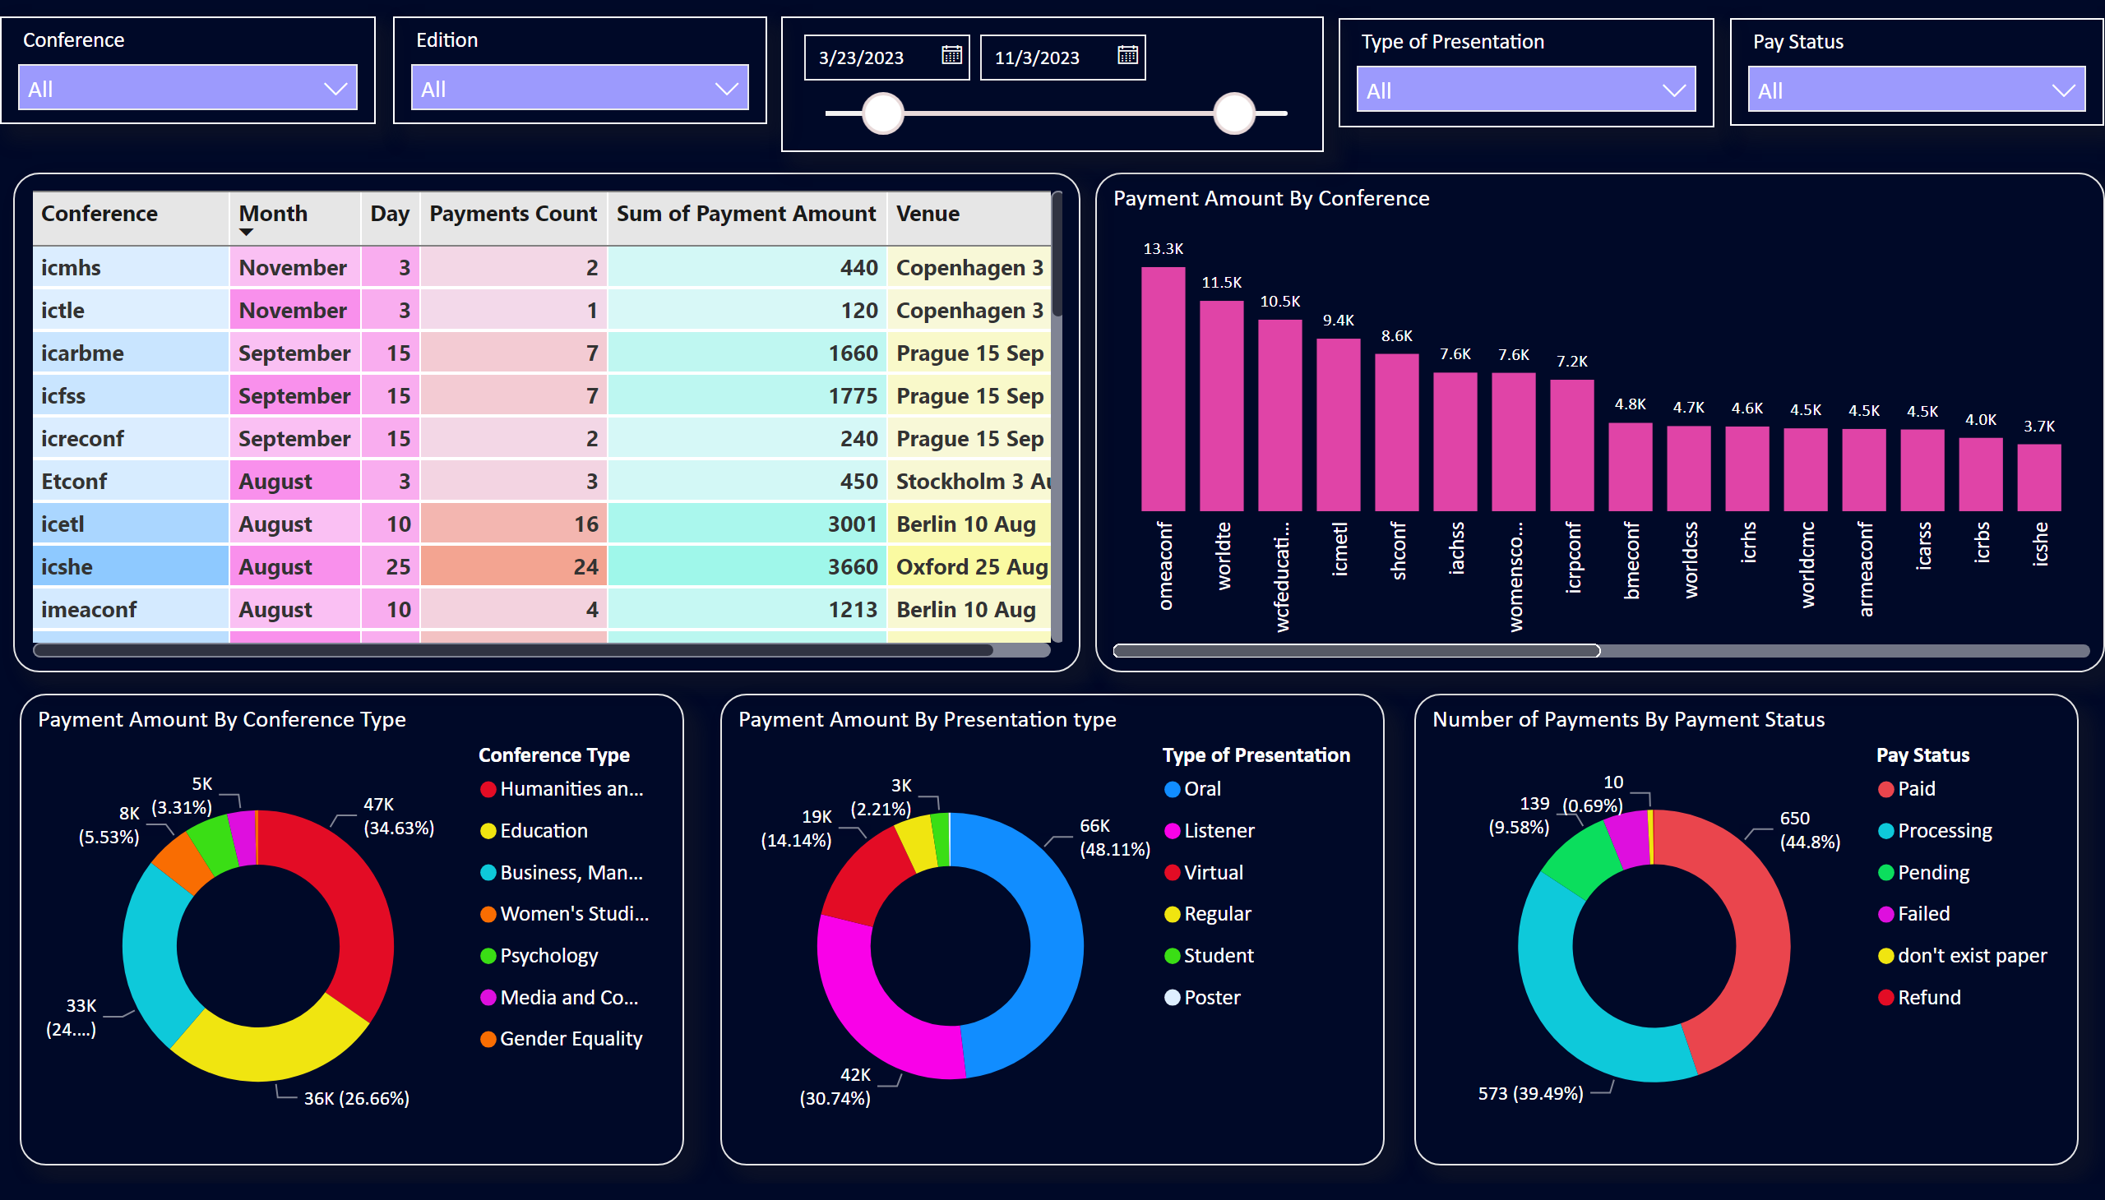
Conference_Payment
Notes:
slicer
No alt text provided
Payment Amount By Conference & Holding Date
No alt text provided
slicer
No alt text provided
Payment Amount By Conference Type
No alt text provided
Payment Amount By Presentation type
No alt text provided
Number of Payments By Payment Status
No alt text provided
slicer
No alt text provided
Payment Amount By Conference
No alt text provided
slicer
No alt text provided
slicer
No alt text provided

Slide 4
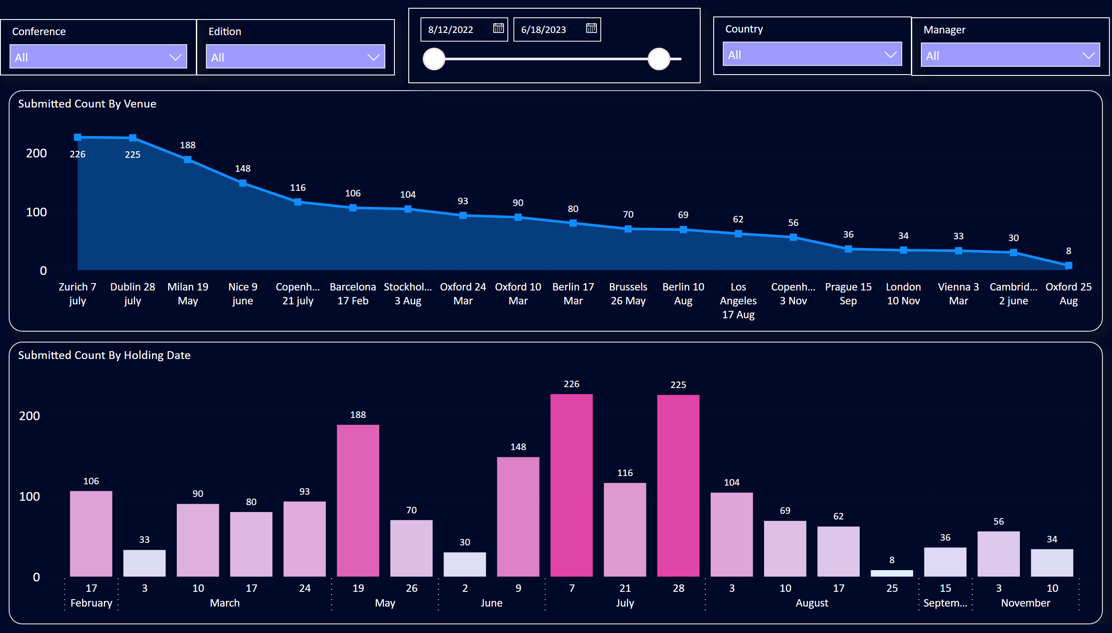
Venue_Submission
Notes:
Submitted Count By Venue
No alt text provided
Submitted Count By Holding Date
No alt text provided
slicer
No alt text provided
slicer
No alt text provided
slicer
No alt text provided
slicer
No alt text provided
slicer
No alt text provided

Slide 5
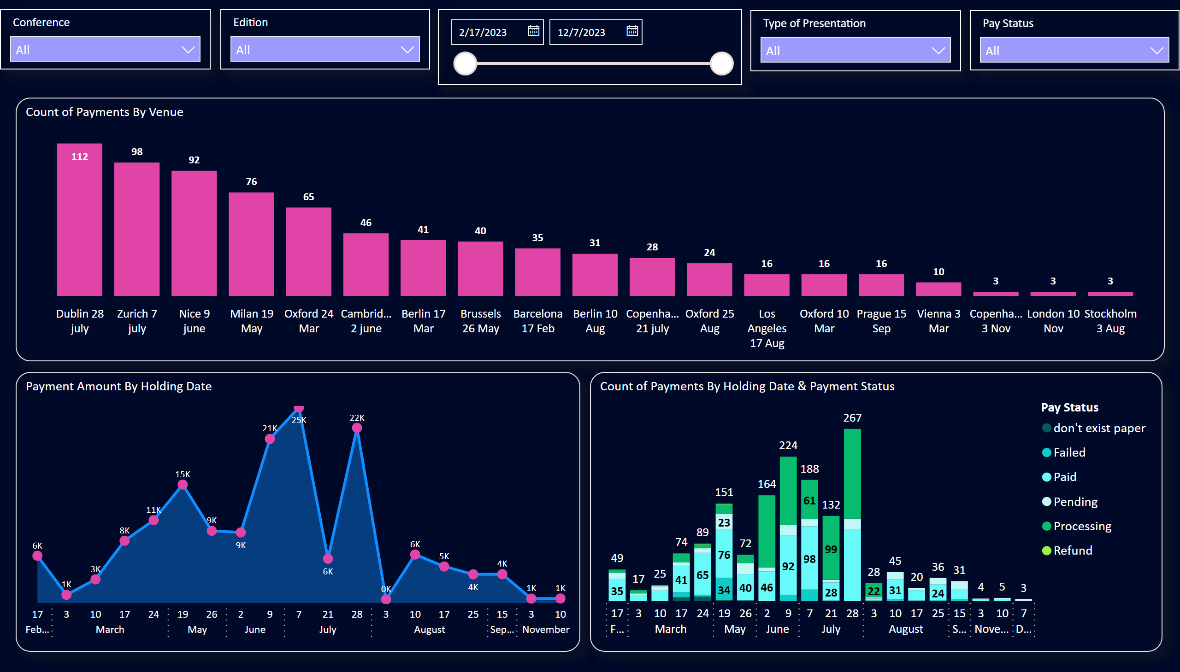
Venue_Payment
Notes:
Payment Amount By Holding Date
No alt text provided
Count of Payments By Venue
No alt text provided
Count of Payments By Holding Date & Payment Status
No alt text provided
slicer
No alt text provided
slicer
No alt text provided
slicer
No alt text provided
slicer
No alt text provided
slicer
No alt text provided

Slide 6
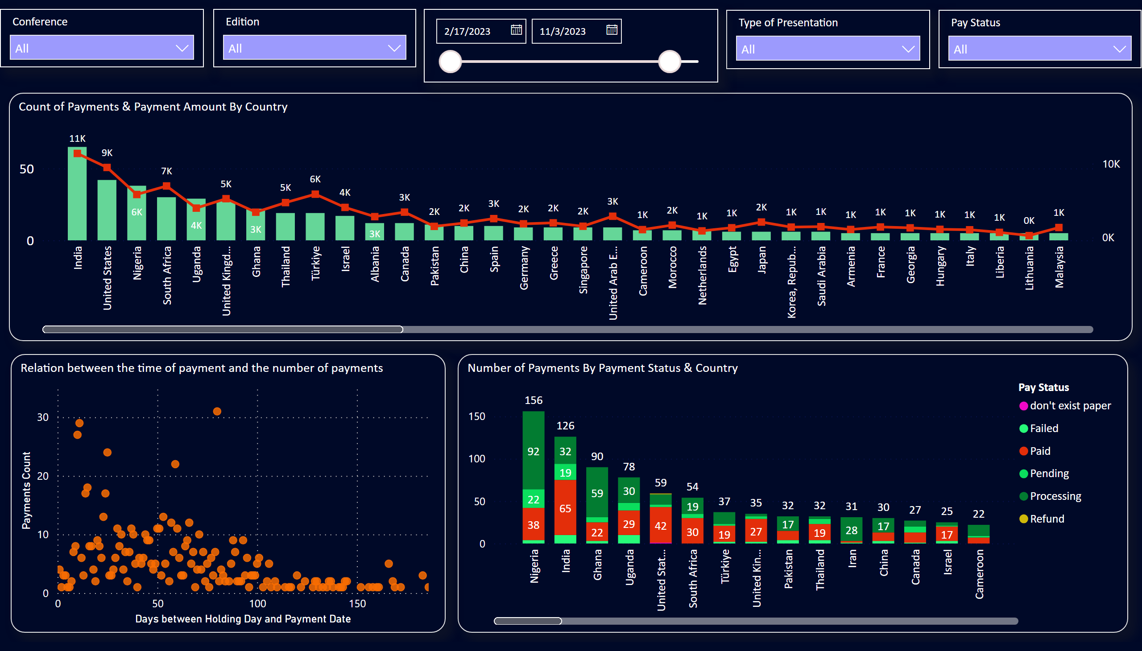
Country
Notes:
Relation between the time of payment and the number of payments
No alt text provided
Number of Payments By Payment Status & Country
No alt text provided
Count of Payments & Payment Amount By Country
No alt text provided
slicer
No alt text provided
slicer
No alt text provided
slicer
No alt text provided
slicer
No alt text provided
slicer
No alt text provided

Slide 7
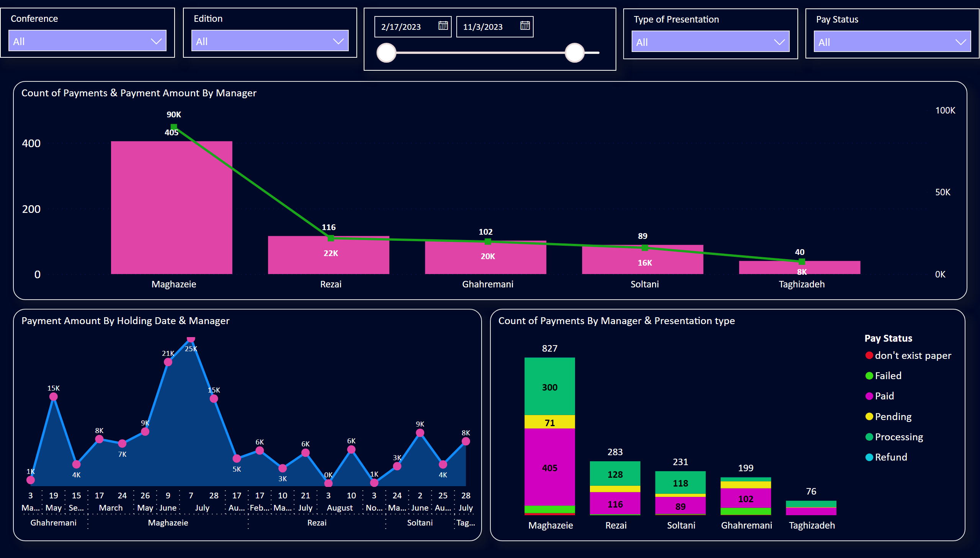
Manager
Notes:
Payment Amount By Holding Date & Manager
No alt text provided
Count of Payments & Payment Amount By Manager
No alt text provided
Count of Payments By Manager & Presentation type
No alt text provided
slicer
No alt text provided
slicer
No alt text provided
slicer
No alt text provided
slicer
No alt text provided
slicer
No alt text provided

Slide 8
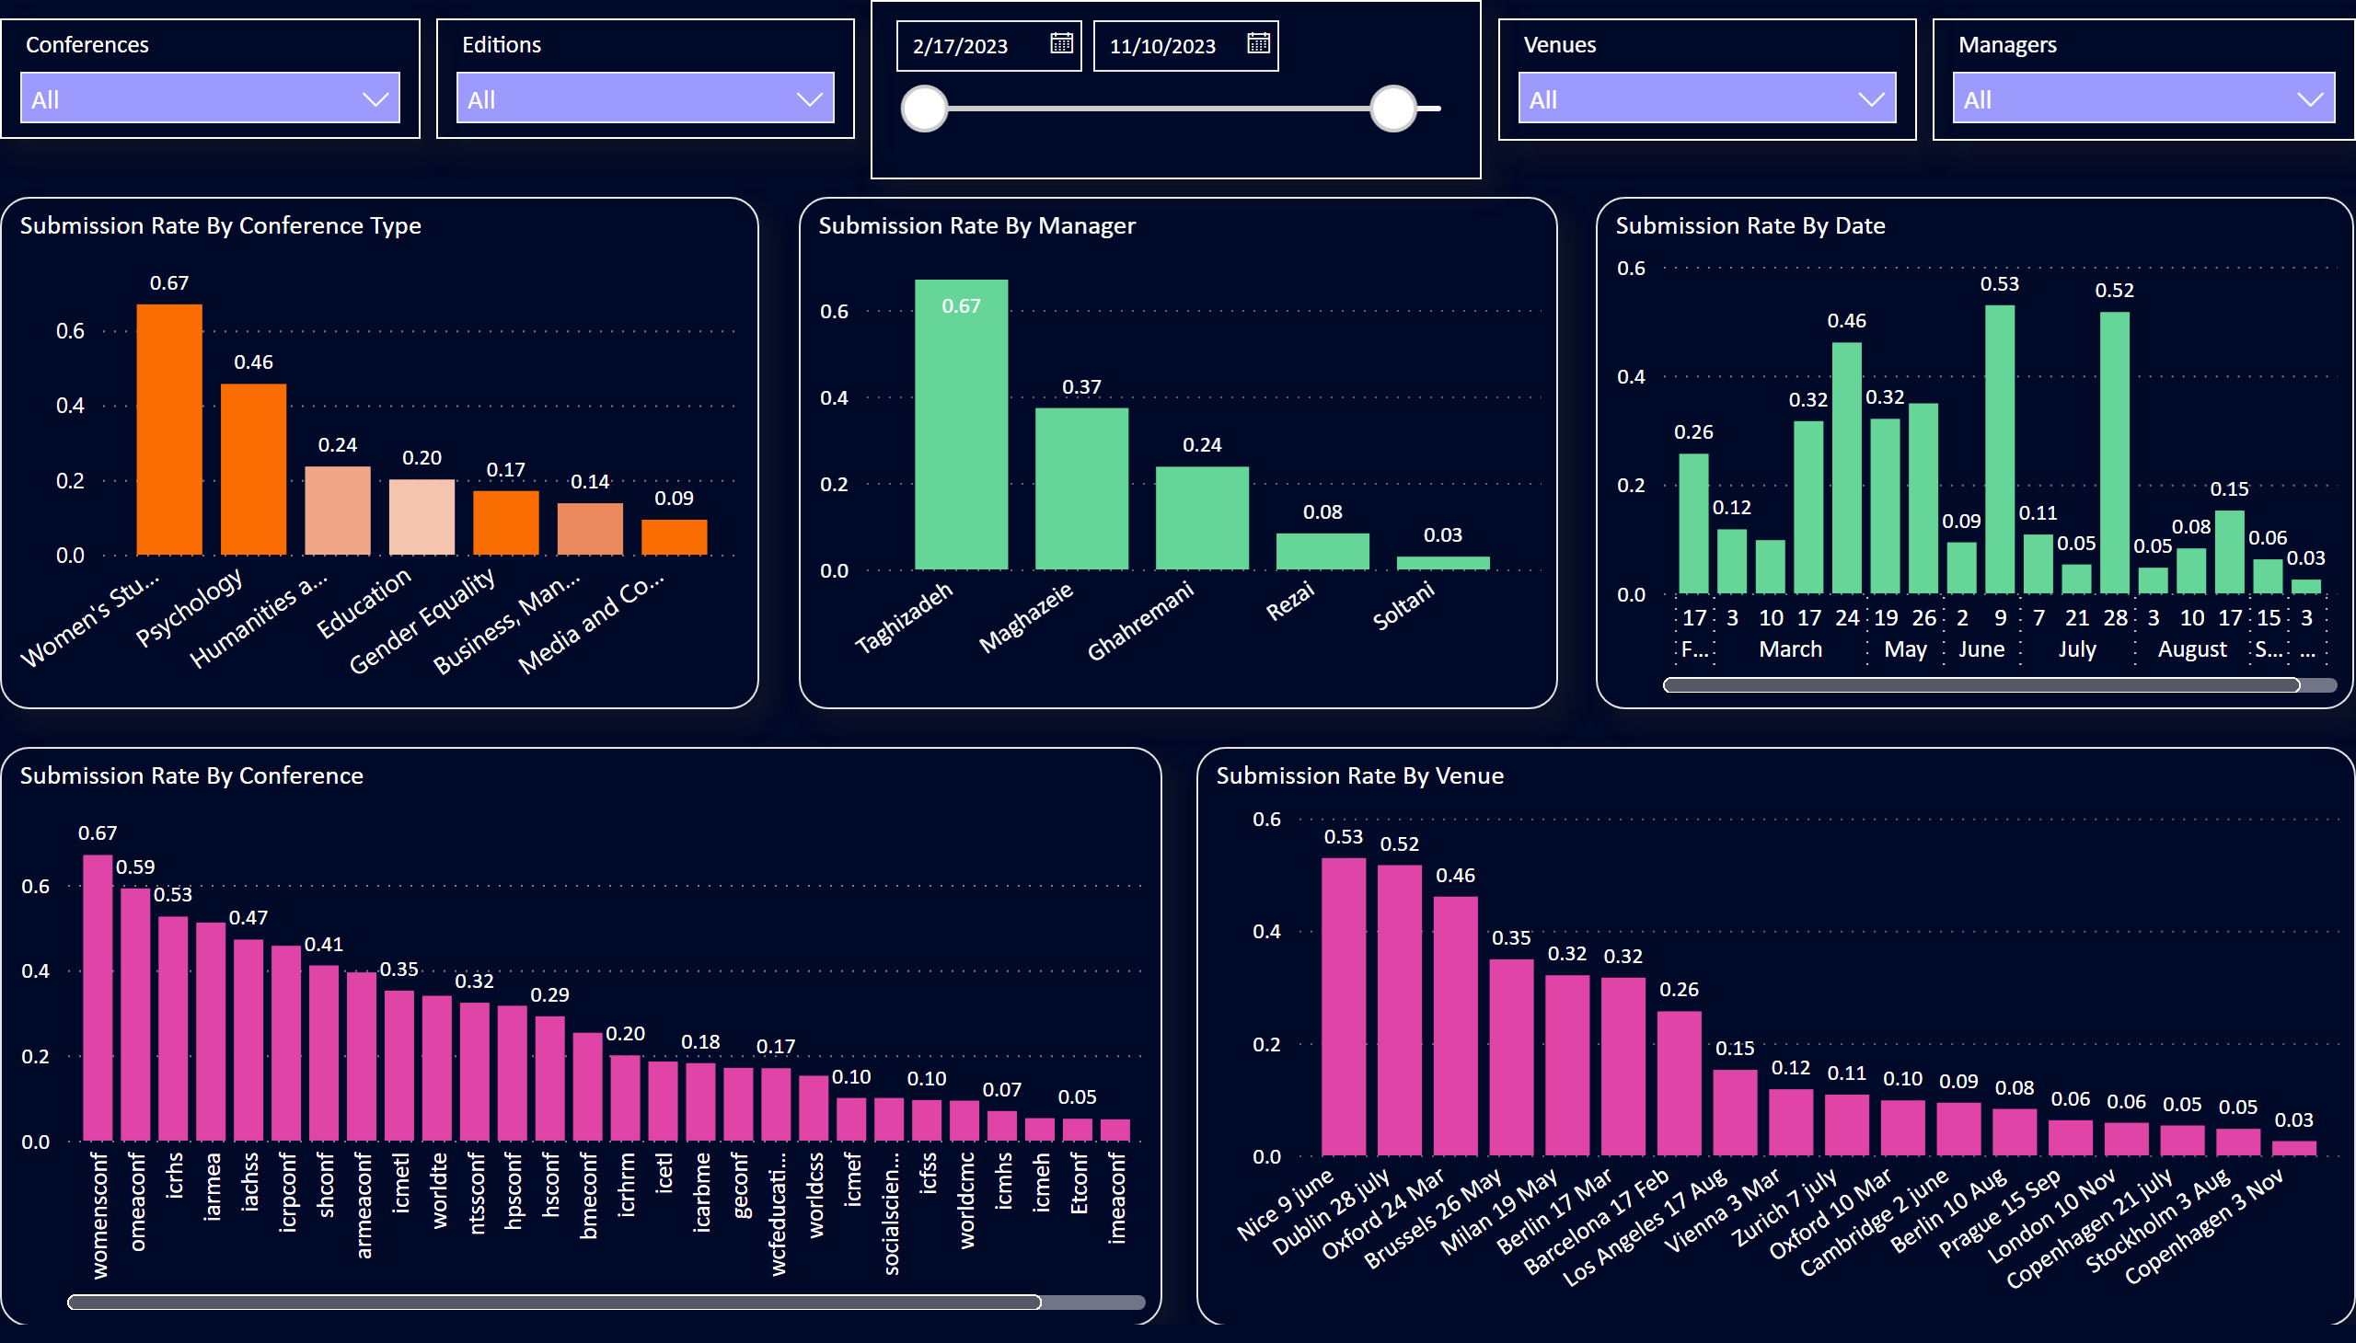
Submission Rate
Notes:
Submission Rate By Venue
No alt text provided
Submission Rate By Manager
No alt text provided
Submission Rate By Date
No alt text provided
Submission Rate By Conference
No alt text provided
slicer
No alt text provided
Submission Rate By Conference Type
No alt text provided
slicer
No alt text provided
slicer
No alt text provided
slicer
No alt text provided
slicer
No alt text provided

